Slide 1
ENSE 374, Milestone 3
Team Explore The World
Mohamed Bashir, Karlee Fidek, Rishabh Prasad
November 13, 2019

Slide 2
MVC Architecture
Project Blurb
We would like to create an application that recommends our users meaningful travel locations based on their interests and preferences, but also inspires them to experience various cultures and parts of the world.

Slide 3
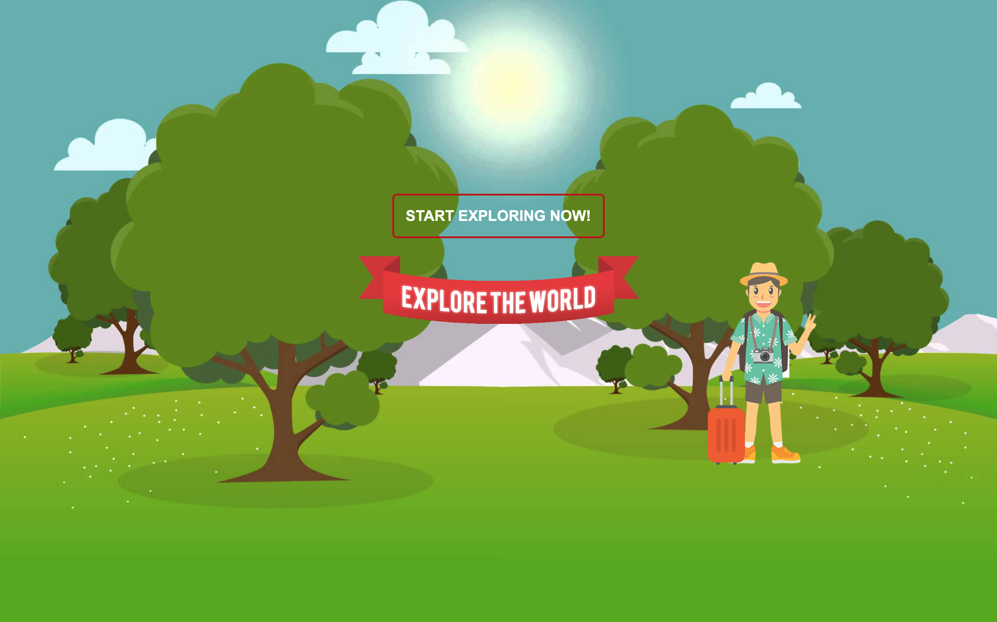
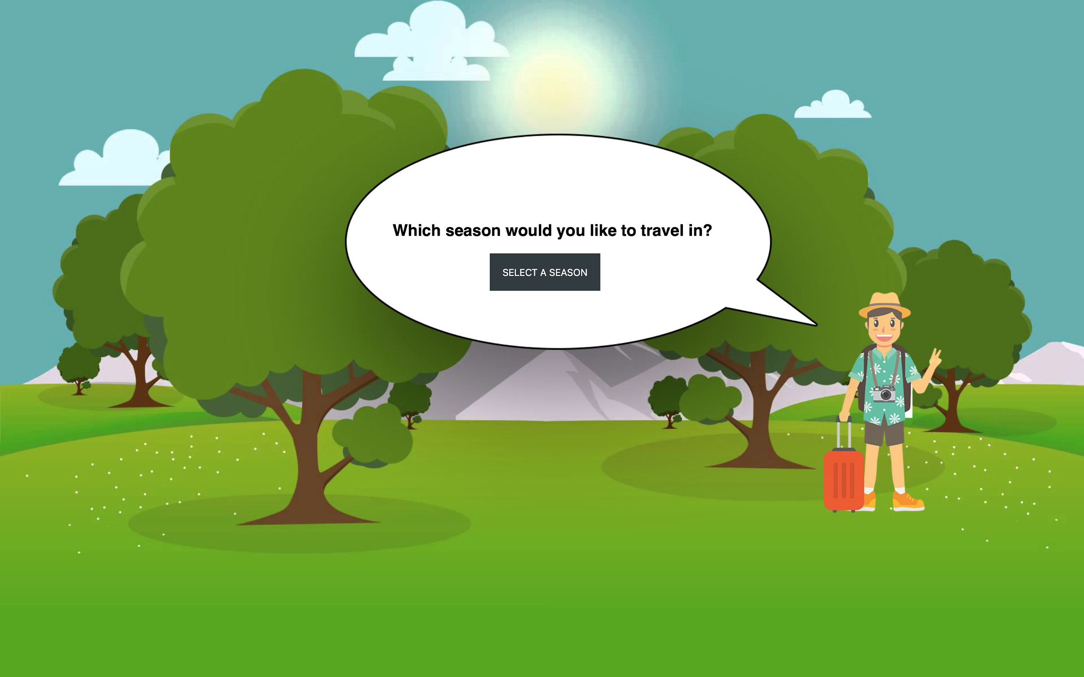
MVP 1 - Interface

Slide 4
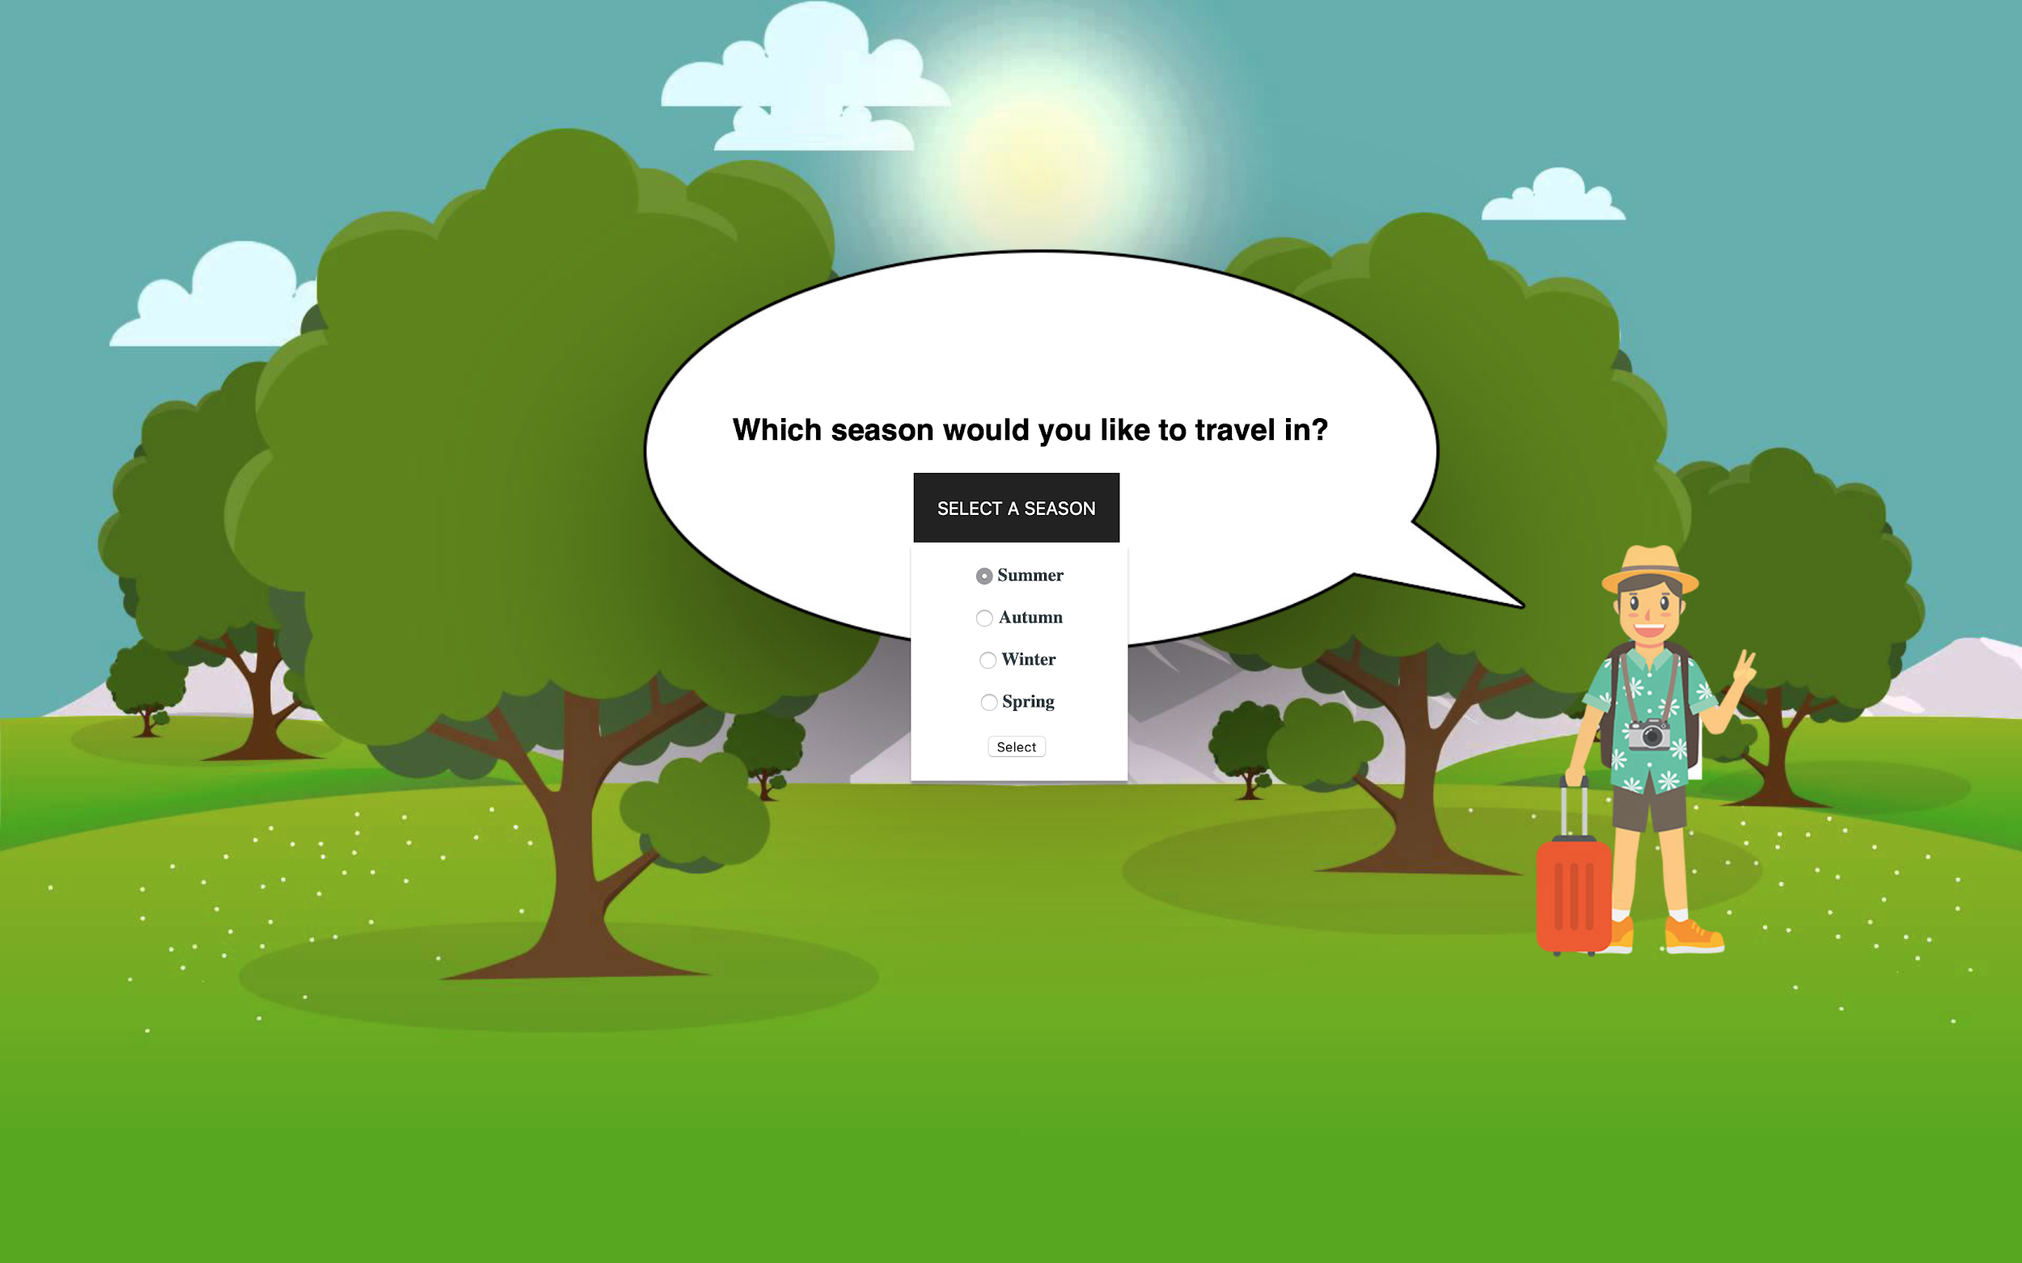
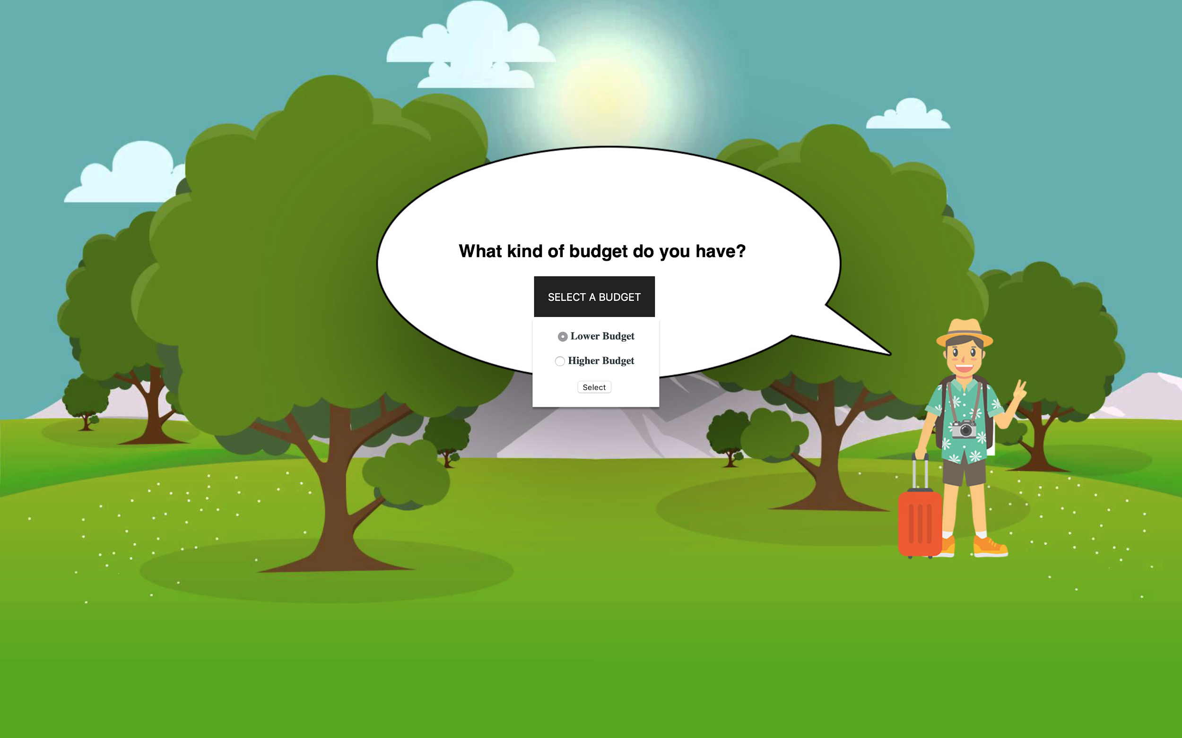
MVP 1 - Interface

Slide 5
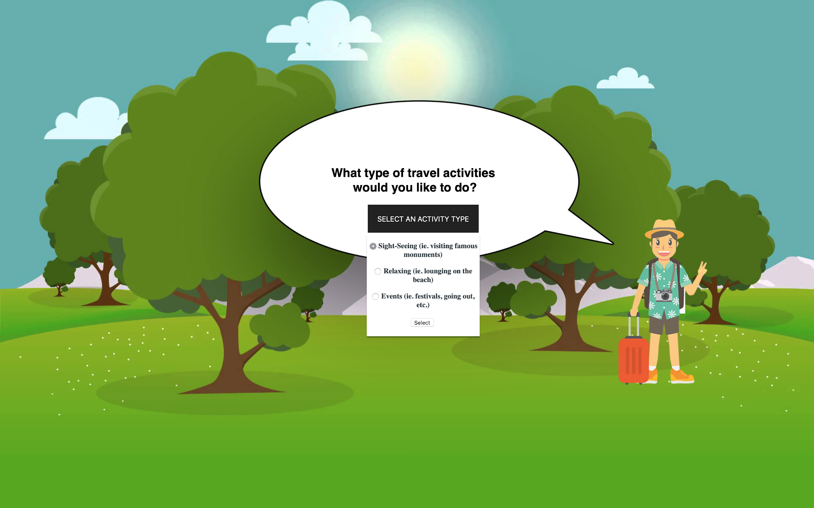
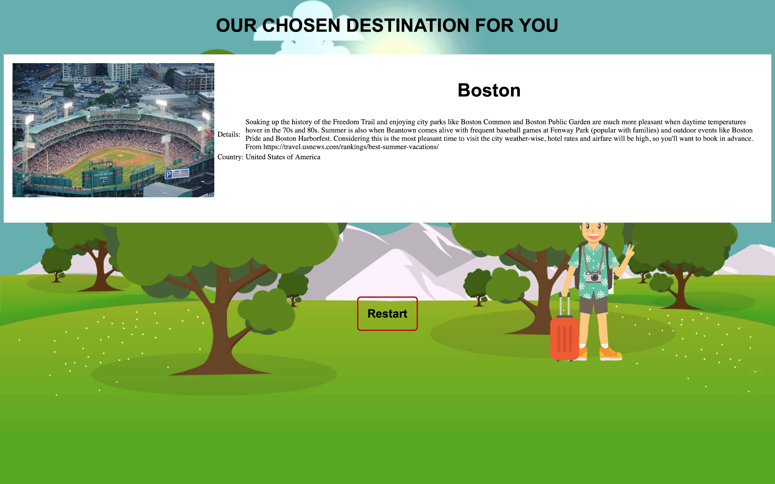
MVP 1 - Interface

Slide 6
MVP 1 demo
Demo
Were we successful in mapping out our envisioned MVP-1?
Our goal was to have one or two user preferences link to a location
Describe why you feel what you have right now is a good MVP
3 preferences, different location recommendations, different pictures, and a small description for each location
Is our code clean?
We believe our code is clean
Shorter variable names, smaller variable/html spans, easy to understand

Slide 7
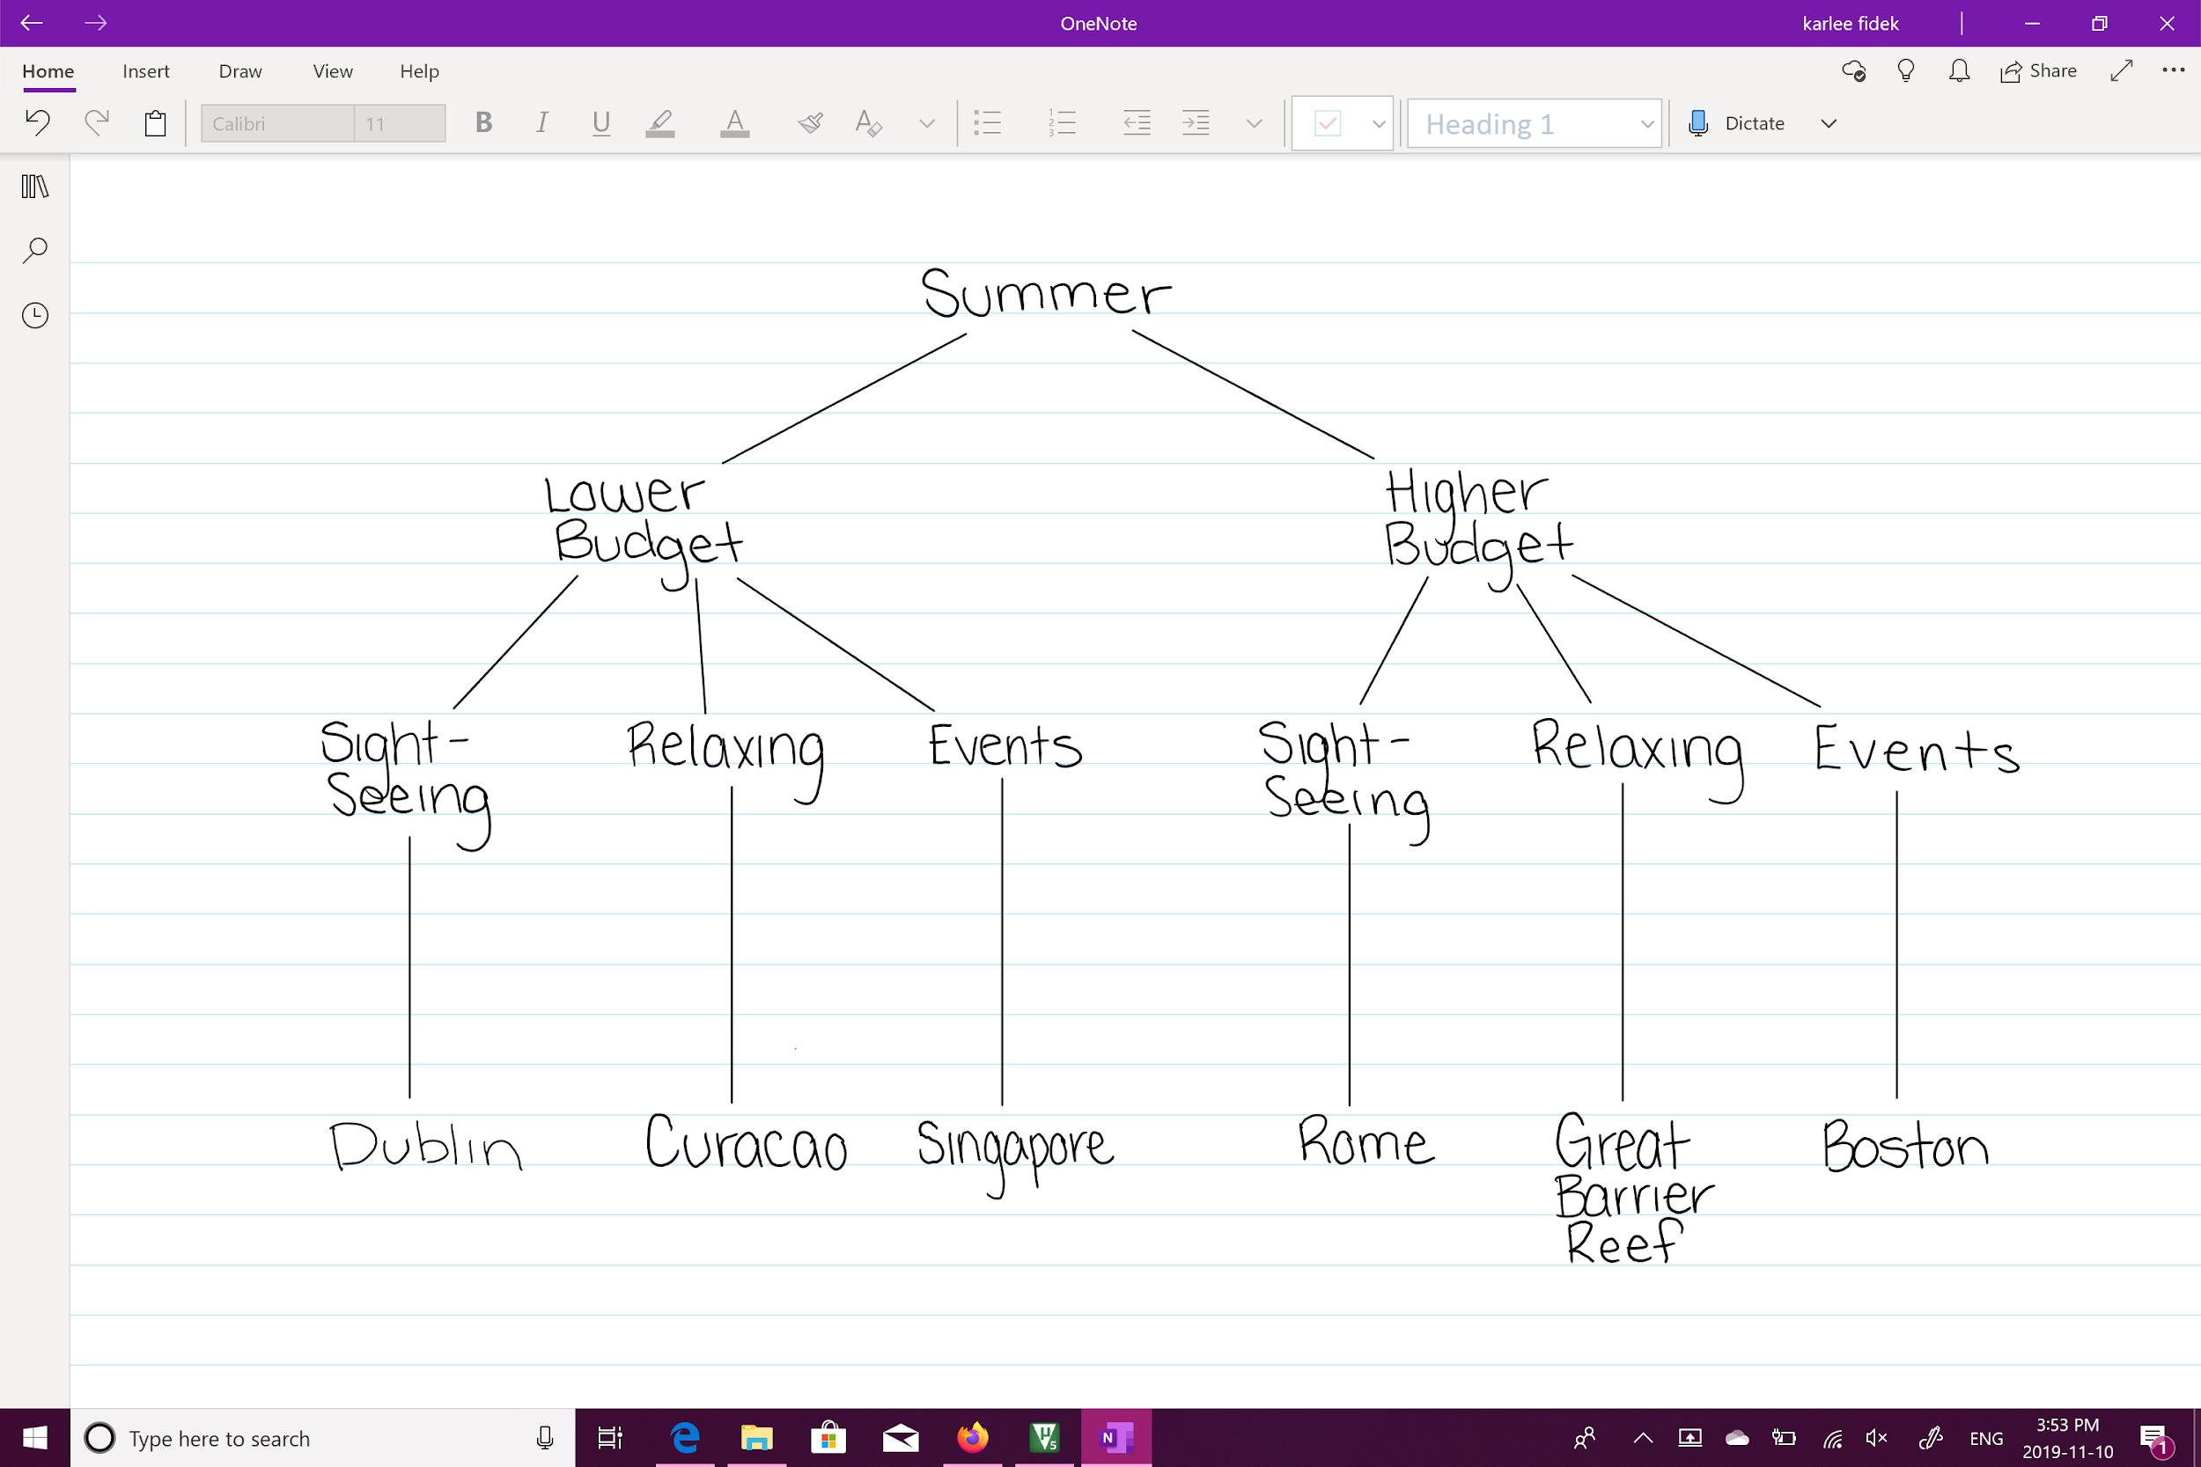
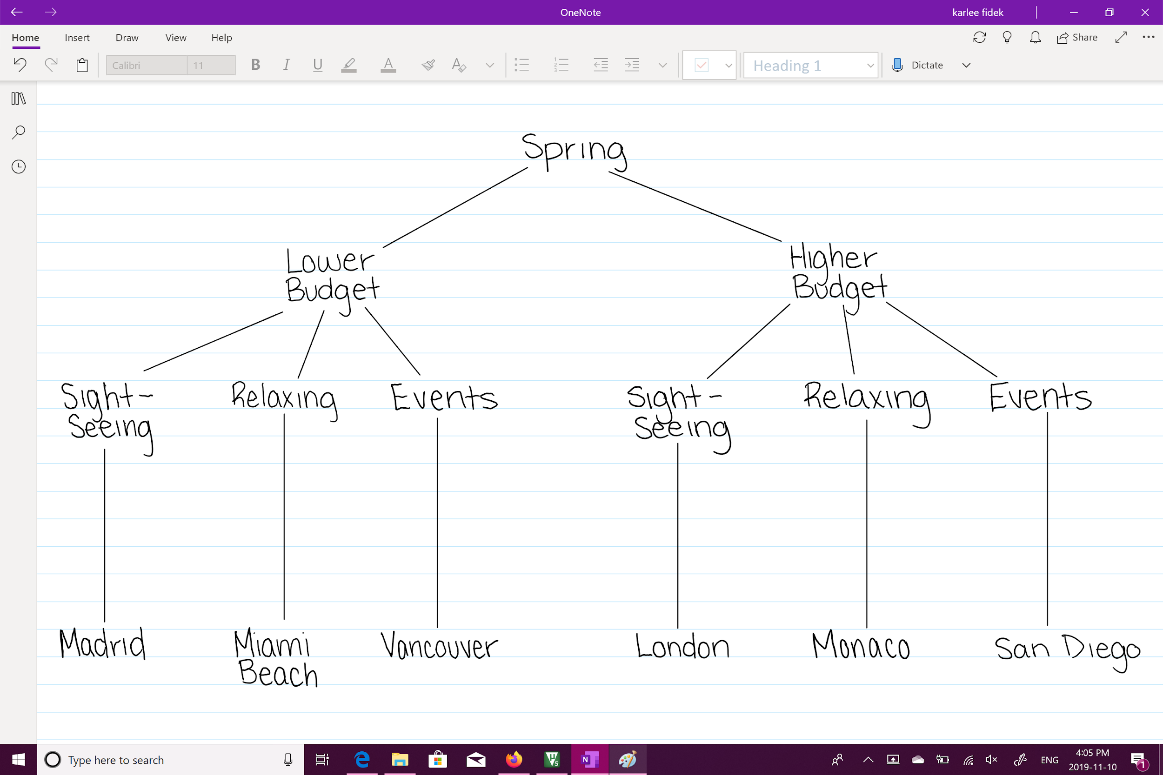
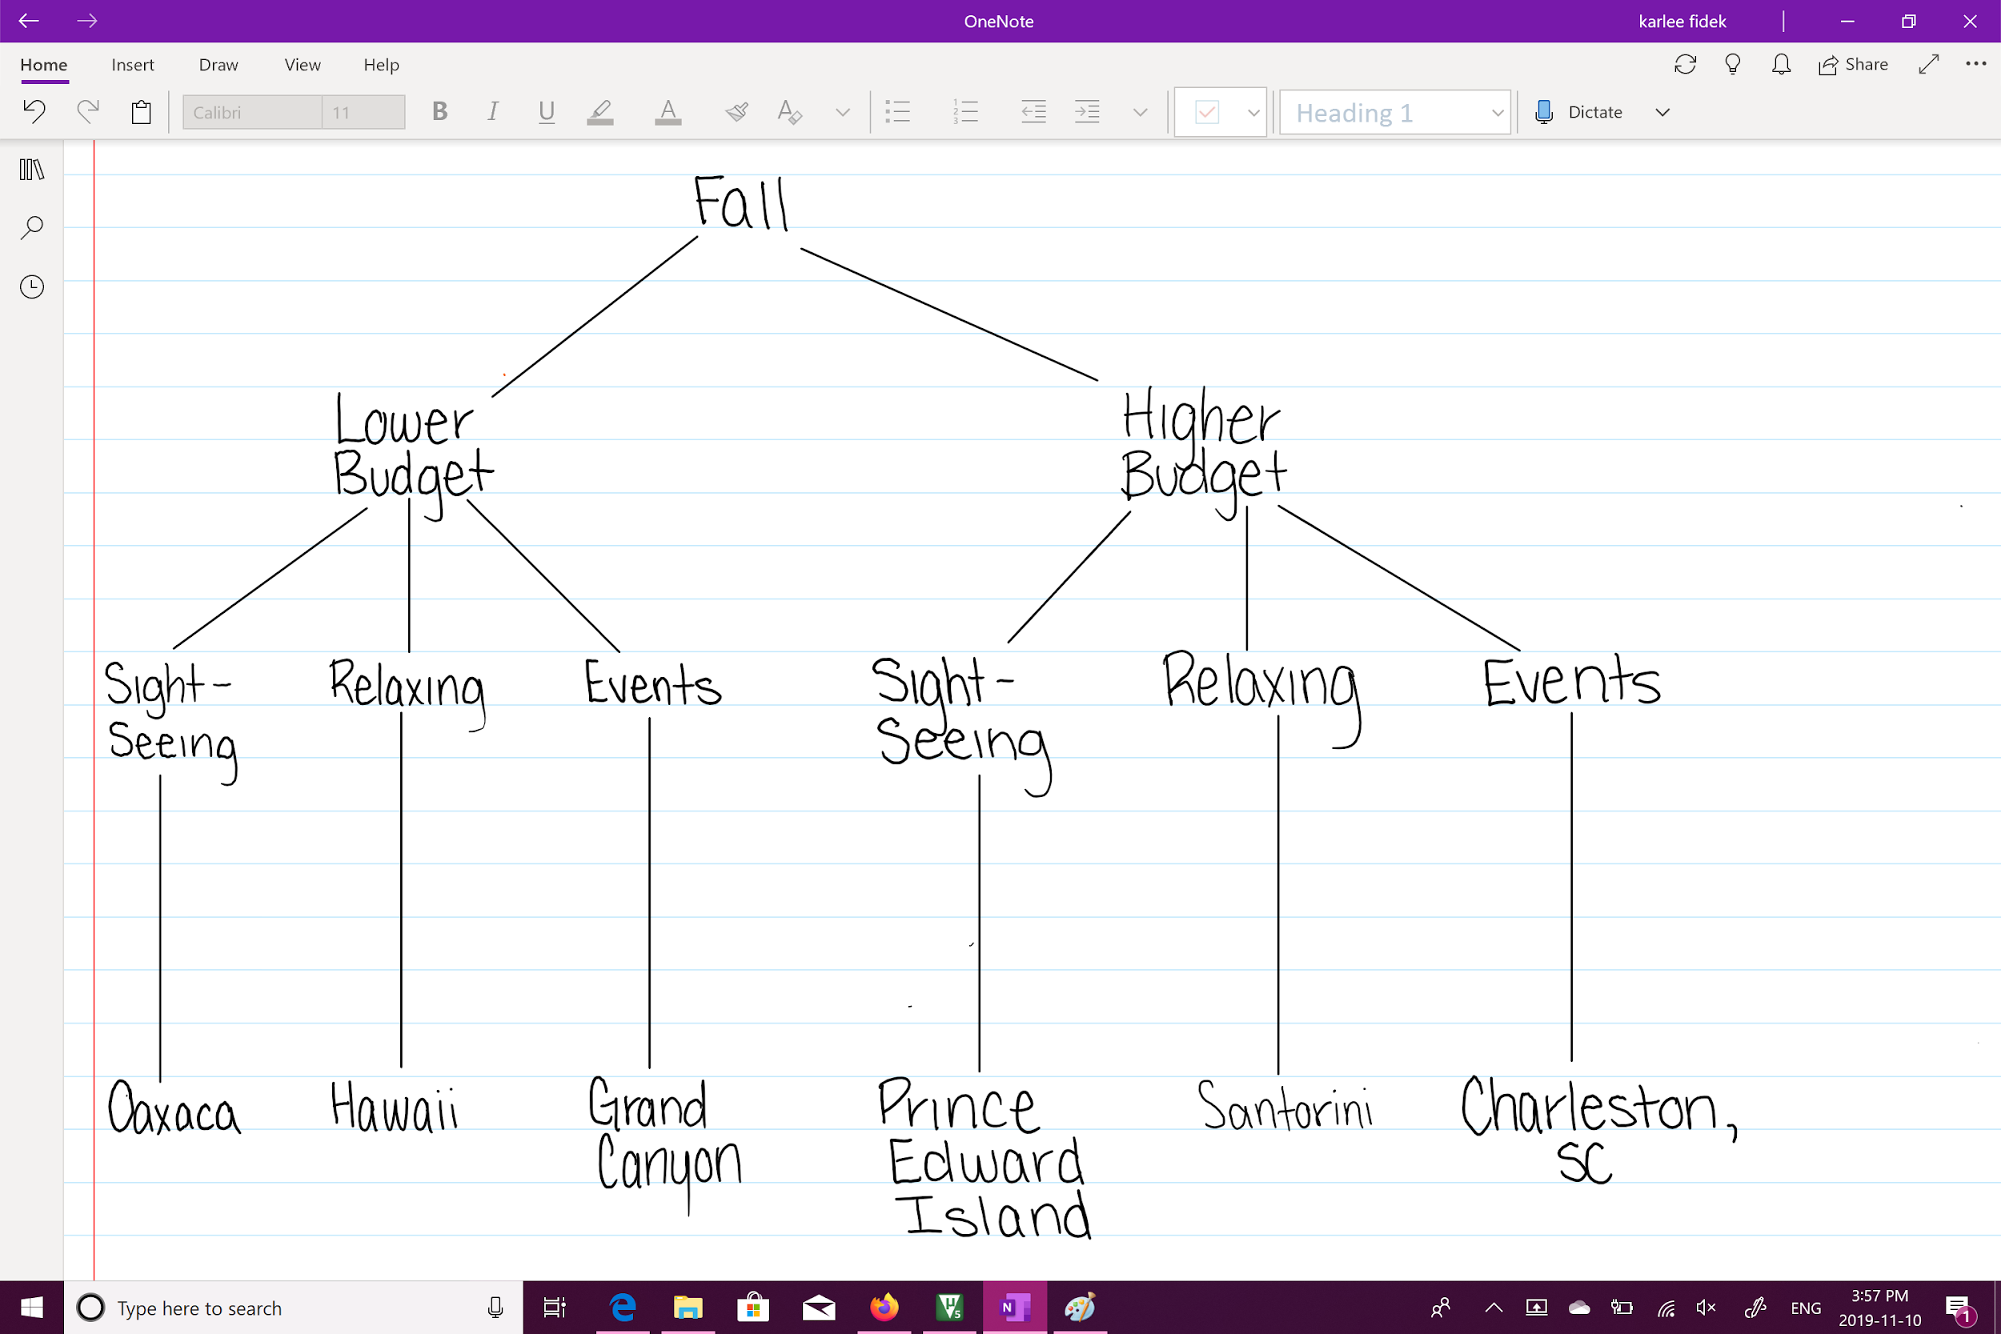
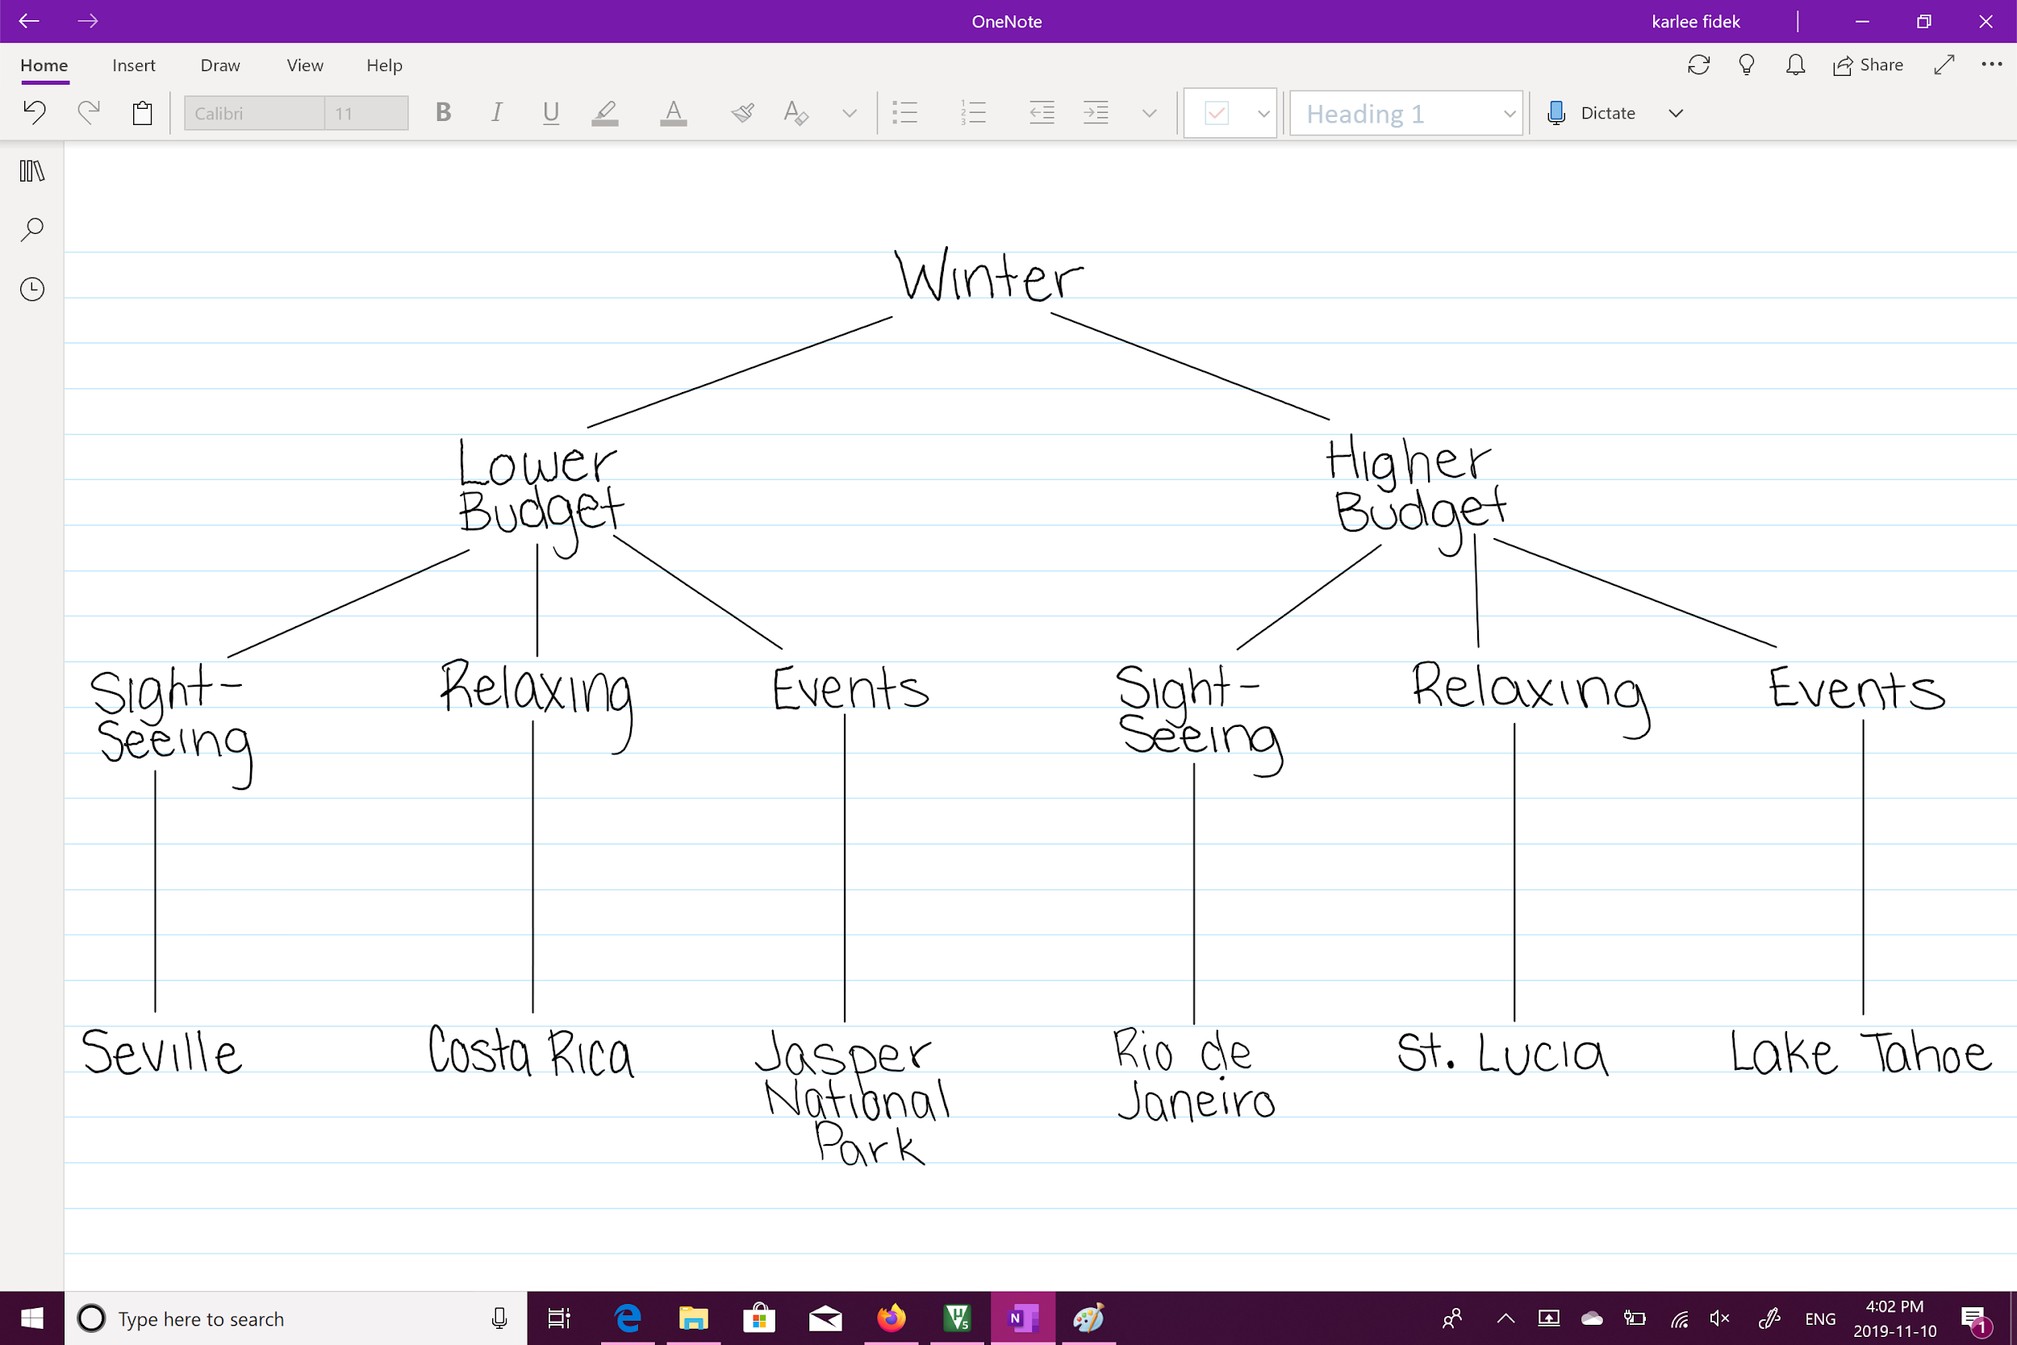
MVP 1 - Location Diagrams

Slide 8
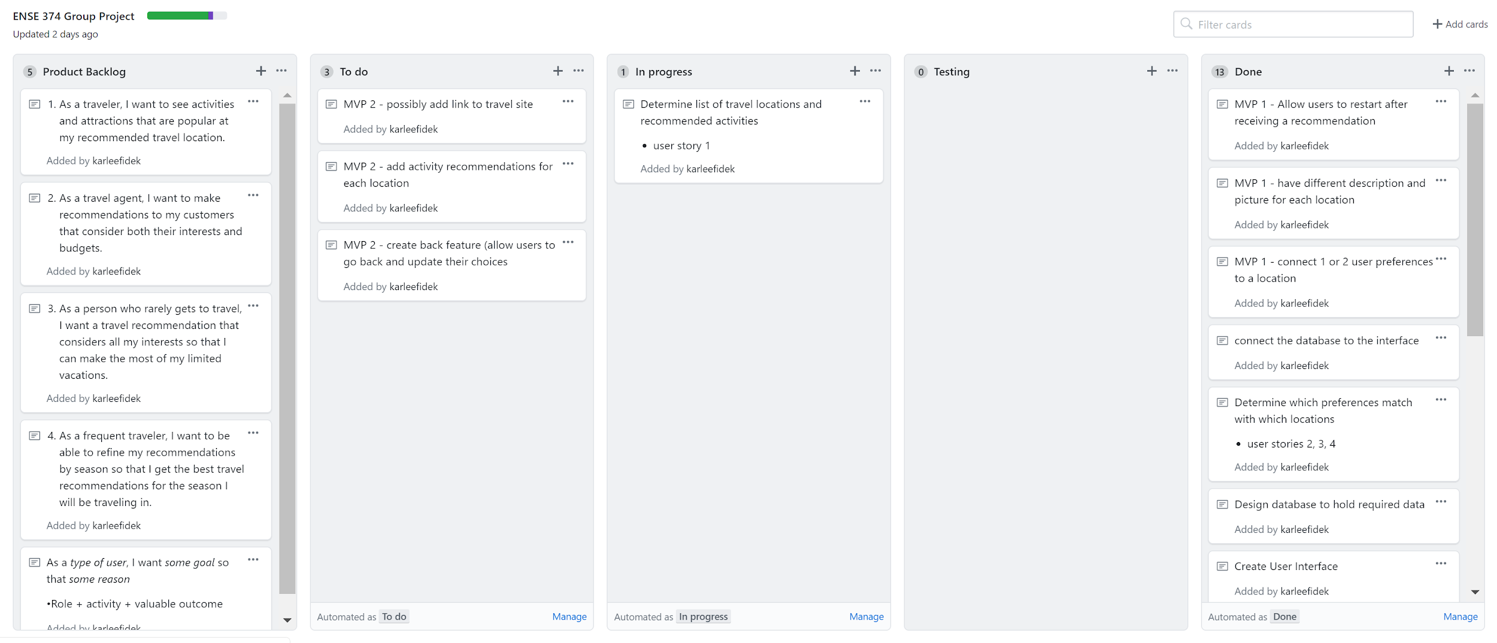
Development Changes

Slide 9
MVP-2 & GitHub
Activity suggestions, back button, website links for more information, possibly an interactive map
Barriers to success? Implementing the interactive map, ability to implement the widget?

Slide 10
Group reflection
How did you feel about this milestone? What did you like about it? What did you dislike?
We liked the fact that we have a working product which exceeded our expectations for the first MVP, however, we felt a little rushed.
What did you learn about yourself as you collaborated and worked through this milestone?
We faced some communication issues with being on the same page with the tasks each of us were assigned.
How will you use what you have learned going forward?
We need to communicate more frequently and make sure that everyone is on the same page at all times

